Slide 1
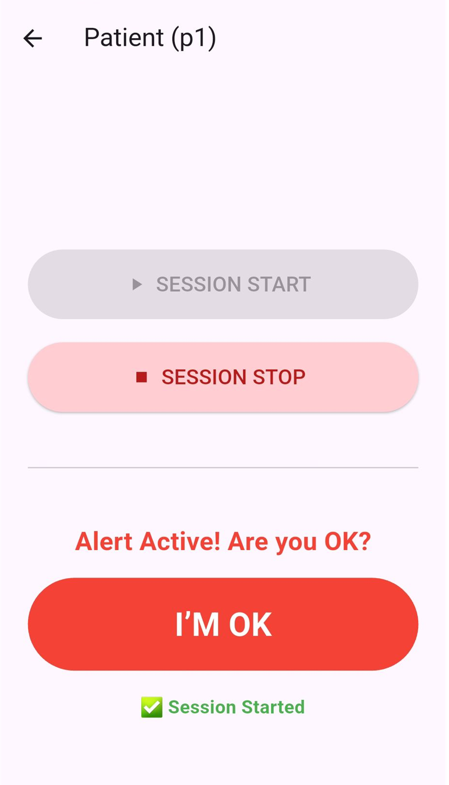
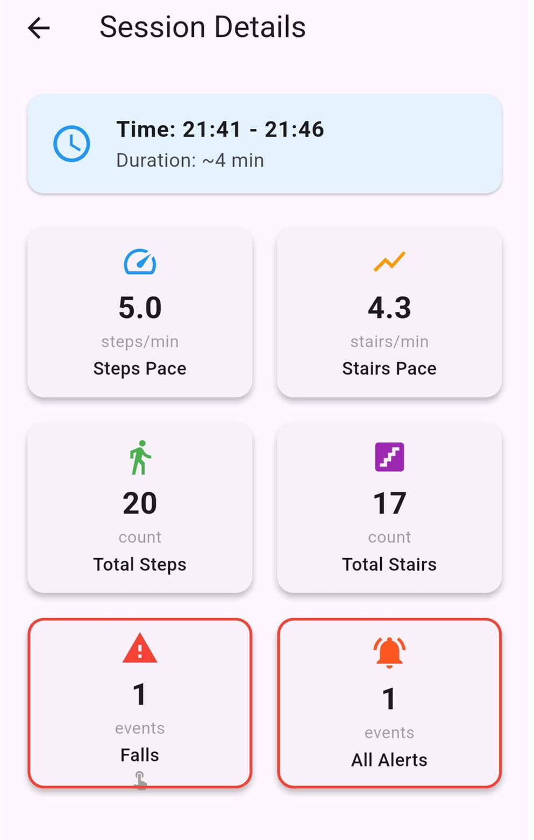
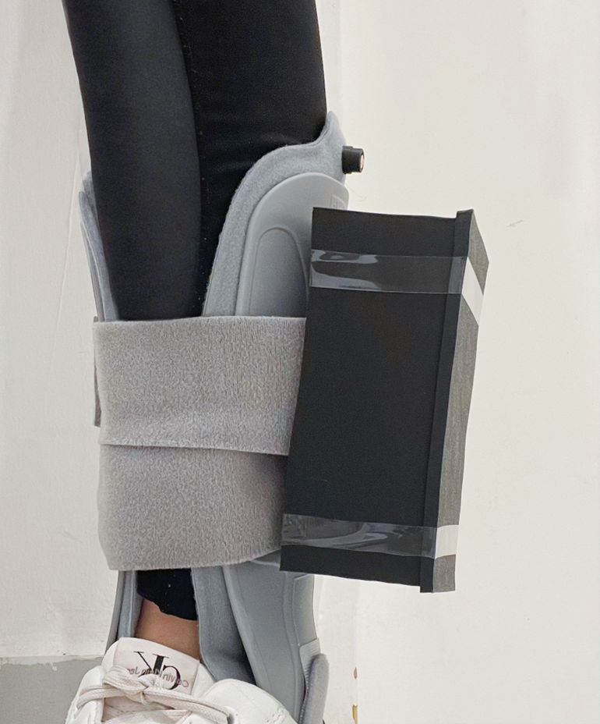
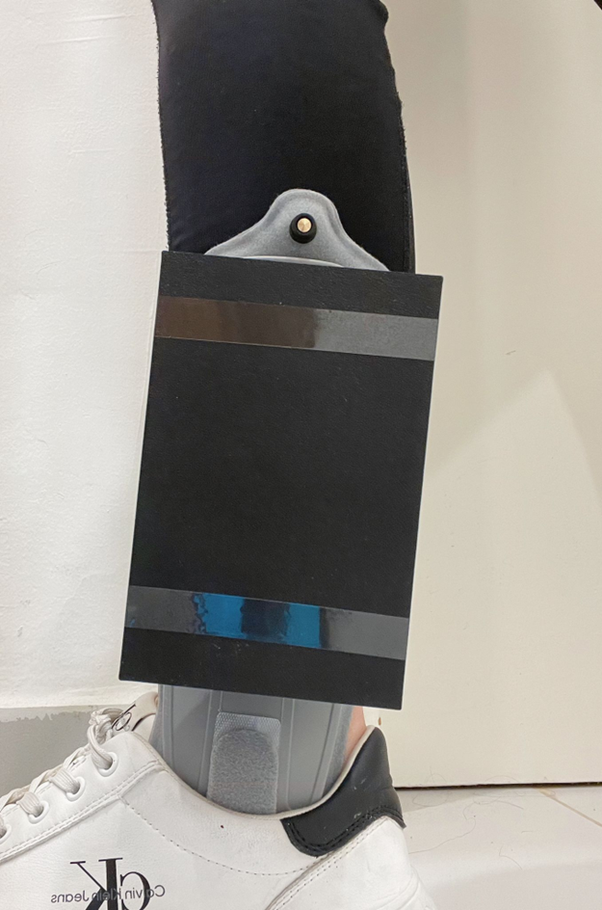
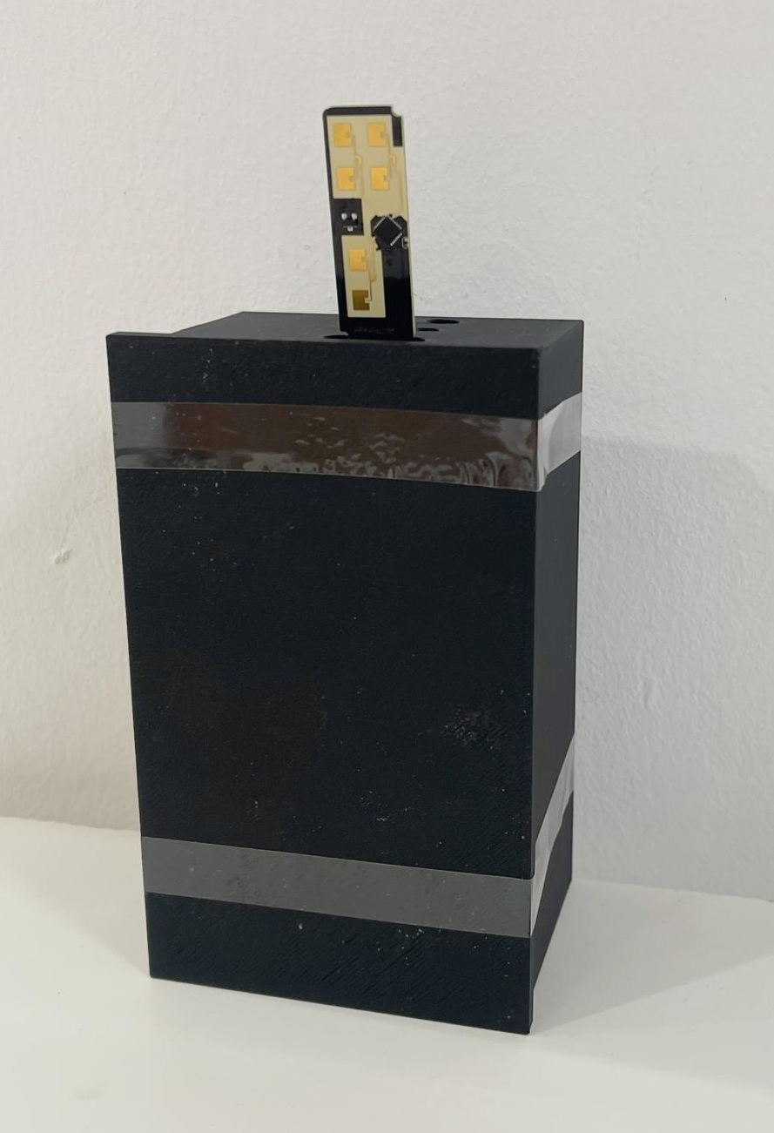
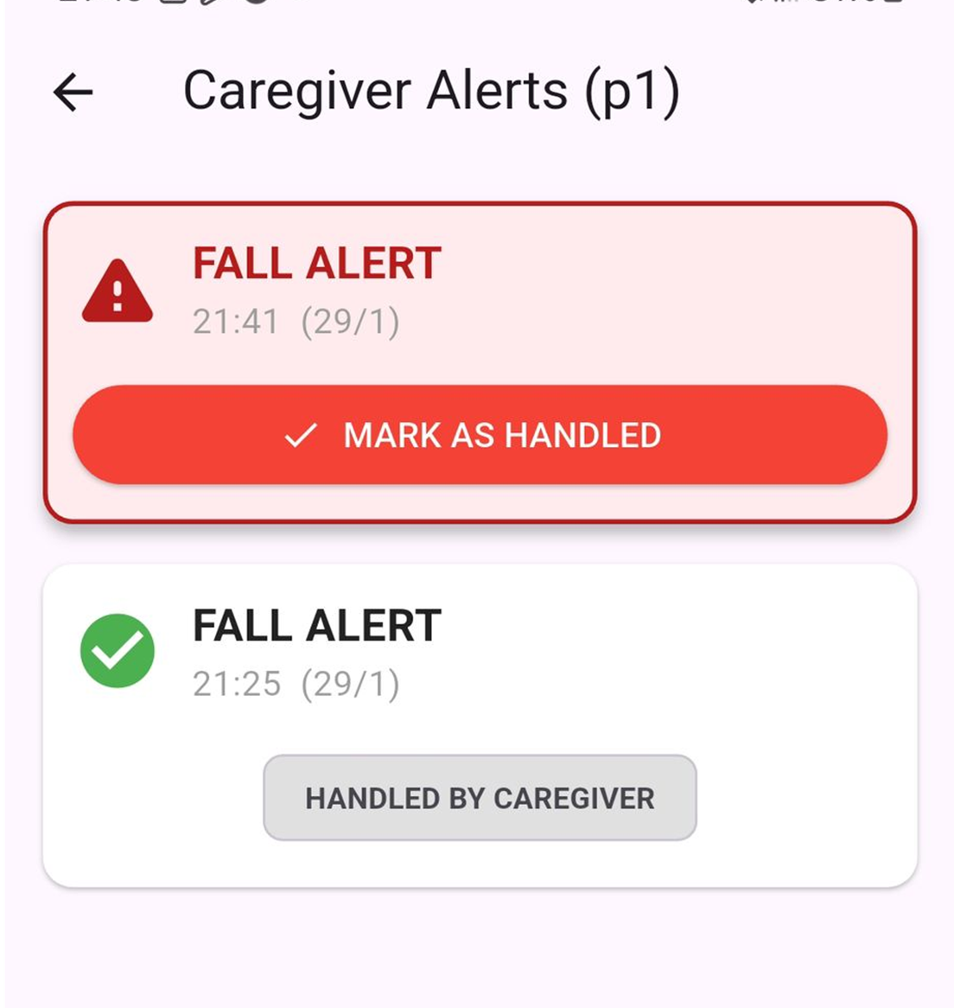
Patient Motion Monitoring System
Our project is an IoT rehabilitation monitoring system designed to safely track patient recovery at home without intrusive surveillance. Combining a leg-worn IMU and room radar, the system operates on patient-activated sessions to measure steps, stair climbing, and basic movement states while simultaneously monitoring for falls and prolonged immobility. To ensure safety without false alarms, the system alerts a helper only if the patient fails to confirm they are okay. Uniquely, it provides doctors with both a real-time view of the current session and detailed historical summaries, translating raw sensor data into actionable clinical metrics—such as specific step counts and activity duration—to support data-driven adjustments to the rehabilitation plan.
Raneen Haj Yahya , Mariam Assdi ,Gharam Kharabna
Itai Darban + Tom Sofer

